Slide 1

BY
LOGESHWARAN.V
AVINASH.R
KAMESHWARAN.K

Slide 2
Mastering Interview Techniques
Key strategies for effective interview preparation and
performance.

Slide 3
Introduction
What is an interview ?
An interview is a conversation where an employer evaluates a candidate for a job. It can be in person, over the phone, or online. The goal is to assess skills, experience, and suitability for the role. Success comes from preparation, clear communication, and confidence.

Slide 4
01
Types of Interviews

Slide 5



Traditional face-to-face interviews: One-on-one meetings with hiring managers.
Group interviews: Candidates interact in a group setting, showcasing teamwork and leadership.
Phone and video interviews: Remote interviews that require strong verbal communication.

Slide 6


Panel interviews: Multiple interviewers ask questions, requiring adaptability.
Behavioral and situational interviews: Employers assess how candidates handled past situations.

Slide 7
02
Preparing for an Interview

Slide 8



Company Research: Learn about its mission, values, and recent news.
Understanding the Role: Analyze the job description and required skills.
Common Interview Questions: Prepare for questions like “Tell me about yourself” and “What are your strengths?”

Slide 9

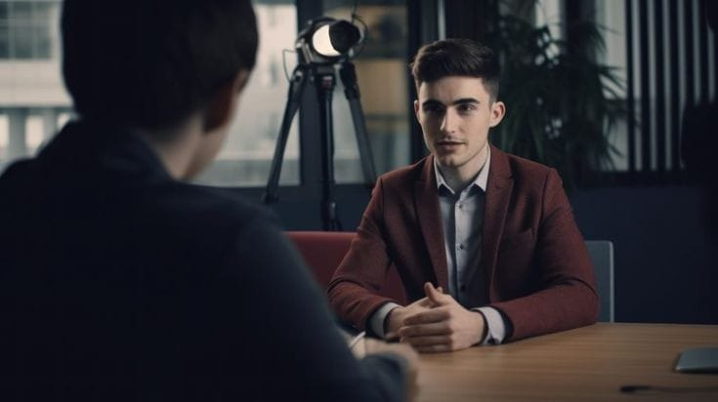
Dress Code: Professional attire suitable for the industry.
Documents: Resume, certificates, portfolio, and references.

Slide 10
03
Effective Communication

Slide 11
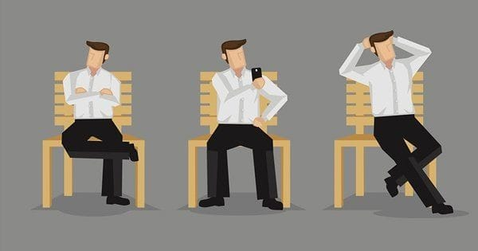
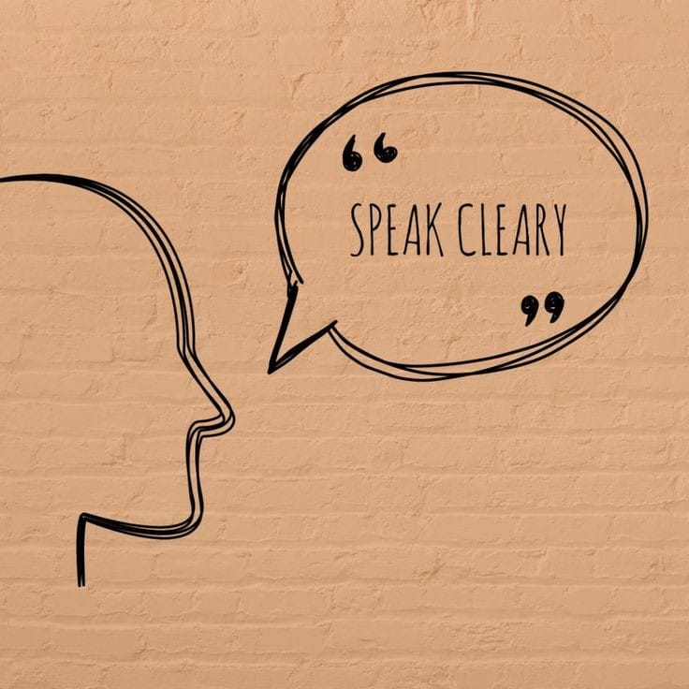
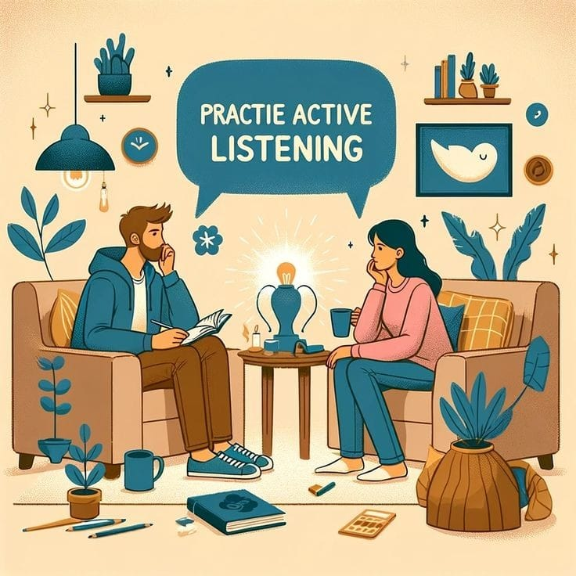
Body language: Maintain eye contact, sit upright, and use gestures naturally.
Speaking clearly: Avoid filler words and structure responses concisely.
Active listening: Engage with the interviewer and respond thoughtfully.

Slide 12
04
Answering Questions Strategically

Slide 13
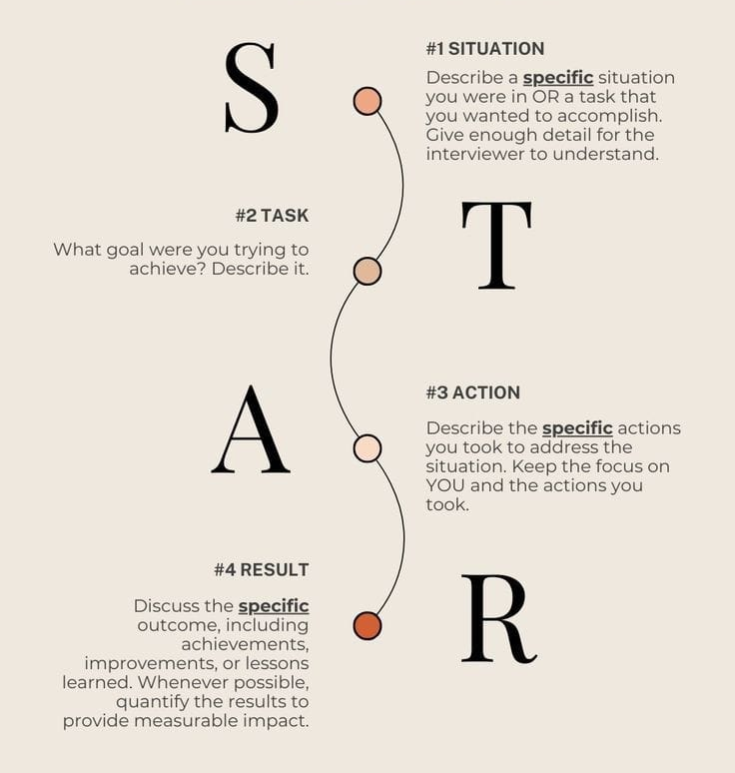
Use the STAR method:
  Situation: Describe a relevant challenge.
  Task: Explain your role.
  Action: Detail the steps taken.
  Result: Share the positive outcome.

Slide 14
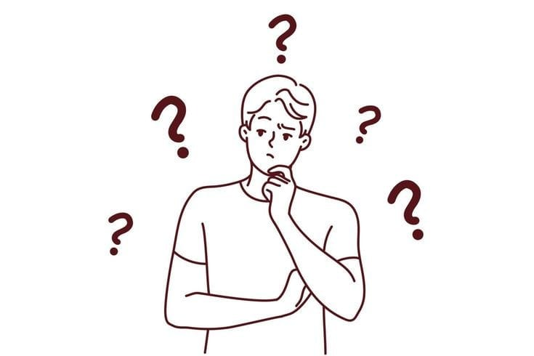

Handling tricky questions: Stay calm, redirect negatives into positives.
Demonstrating confidence: Be genuine but avoid arrogance.

Slide 15
05
Post-Interview Follow-Up

Slide 16


Thank-you email: Express gratitude and reinforce enthusiasm.
Reflect on your performance: Identify areas for improvement.
Stay prepared for future opportunities.

Slide 17
06
Conclusion

Slide 18
Good interview techniques help you make a strong impression. By preparing well, practicing answers, and showing interest in the job, you can boost your confidence and success. Keep learning from each interview to improve and get closer to your career goals.

